Slide 1


Arduino-Based Sign Language Glove using Bluetooth
---> An Embedded systems project

Slide 2
Introduction :
Overview: This project focuses on developing a wearable glove that recognizes sign language gestures and translates them into text or speech using Arduino and Bluetooth. The goal is to create an accessible tool for individuals with hearing impairments, enabling easier communication through sign language.
Importance: Sign language is the primary mode of communication for many individuals with hearing disabilities. However, not everyone is familiar with it. This project aims to bridge that communication gap by creating an automated system to translate sign language into readable text or audible speech.
Technology: The system utilizes Arduino for hardware control, flex sensors to detect finger movements, and Bluetooth for wireless communication to send data to a receiving device (smartphone, PC, etc.). The gesture data is then translated into text or speech.

Slide 3
Project Objectives :
Develop a Wearable Sign Language Recognition Glove
Integrate Bluetooth for Wireless Communication
Convert Gestures into Digital Text or Speech
User-Friendly Interface

Slide 4
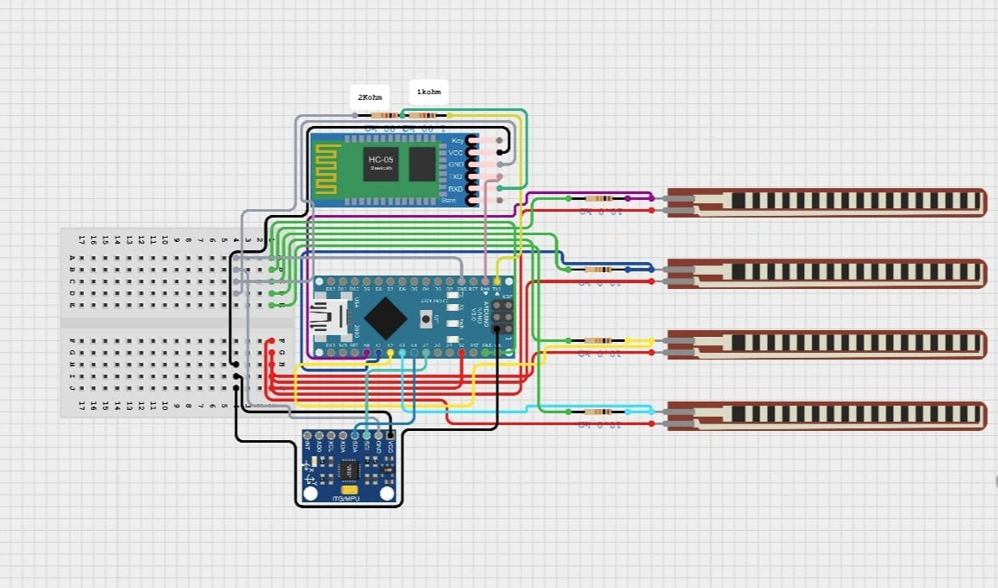
System Architecture :
Components :
Arduino UNO/NANO
Flex Sensors
Bluetooth Module (HC-05)
Accelerometer ADXL
Jumper Wires, Glove
Bread Board, 9V Battery

Slide 5
Hardware Components :
Arduino (e.g., Arduino Uno):
The brain of the system, responsible for reading data from the sensors, processing it, and communicating with the Bluetooth module.
Flex Sensors:
These are placed on the glove to detect finger movements. As the fingers bend, the resistance changes, which the Arduino can read to determine the gesture.
Bluetooth Module (HC-05):
Provides wireless communication between the glove and the receiving device. It uses serial communication to send data to an app or PC.
Accelerometer:
Detects hand orientation and movement, improving gesture recognition accuracy.
Power Source:
A battery or USB power supply is used to provide the necessary power to the system, allowing the glove to remain portable.
Other Components:
-Wires for connecting the components.
- Resistors to ensure proper signal readings.

Slide 6
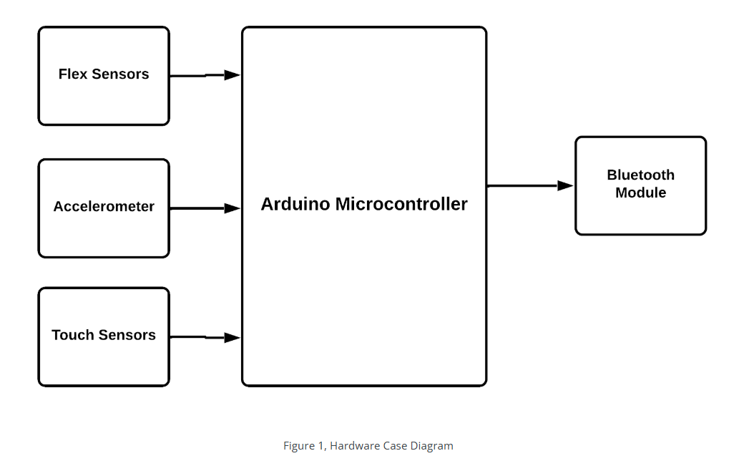
Hardware Case Block Diagram :

Slide 7
Software Components :
Arduino IDE:
Used for programming the Arduino board to handle the input from sensors and transmit data via Bluetooth. The code enables the system to process the sensor data and send the appropriate gestures to the Bluetooth module.
Bluetooth Communication Protocol:
The system uses Bluetooth Serial Port Profile (SPP) for communication. The Arduino sends data to the Bluetooth module, which transmits it to the receiving device via Bluetooth.
Gesture Recognition Algorithm:
Based on the input from the flex sensors, an algorithm identifies specific hand gestures (such as letters or words in sign language). The algorithm processes sensor readings and compares them to pre-defined values for different gestures.
We created a small android Bluetooth application to display output commands in connected device.

Slide 8
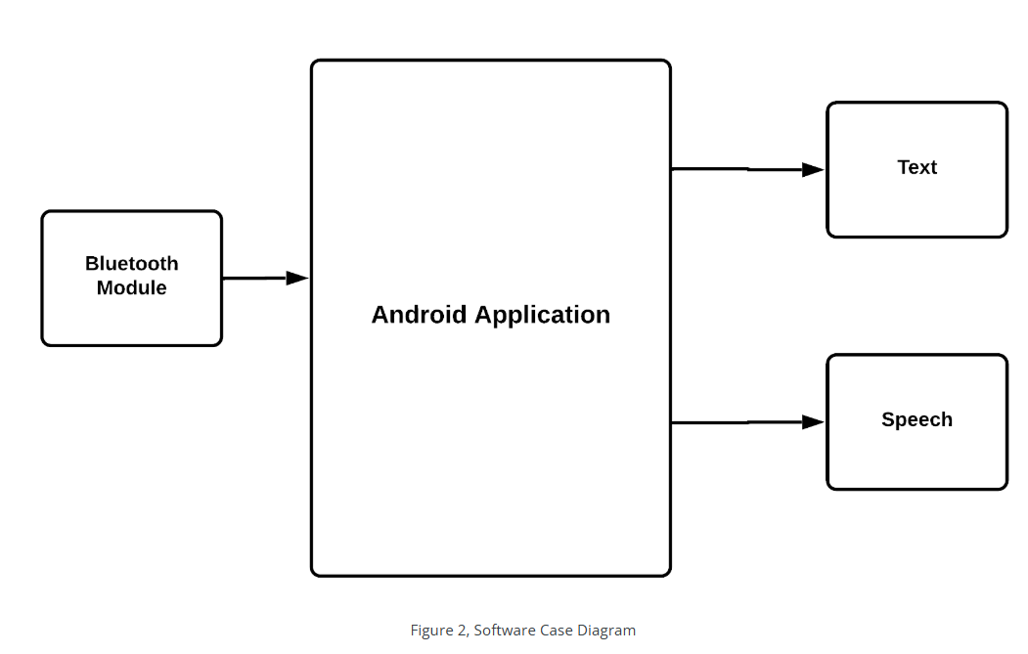
SOFTWARE Case Block Diagram :

Slide 9
Working Mechanism :
Step 1: The user wears the glove and makes a sign language gesture.
Step 2: The flex sensors on the glove detect the bending of the fingers, generating corresponding data.
Step 3: The Arduino processes the data and identifies the gesture based on predefined patterns.
Step 4: The identified gesture is transmitted to a smartphone or computer via Bluetooth.
Step 5: The receiving device translates the gesture into text or speech, providing real-time feedback to the user.

Slide 10
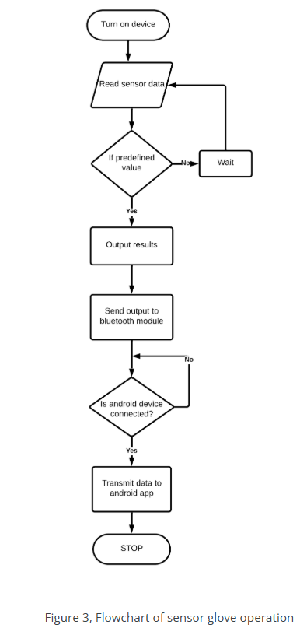
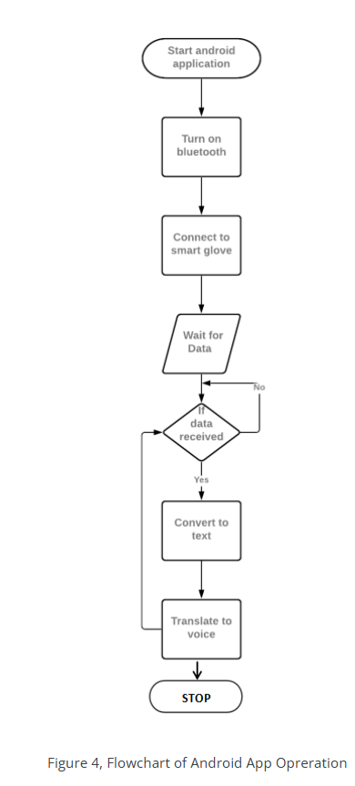
F
L
O
W
C
H
A
R
T
S

Slide 11
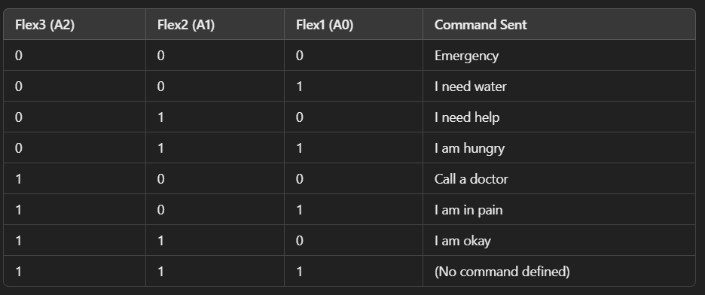
TRUTH TABLE FOR COMMANDS USING 3-BITS (8 variations) :

Slide 12
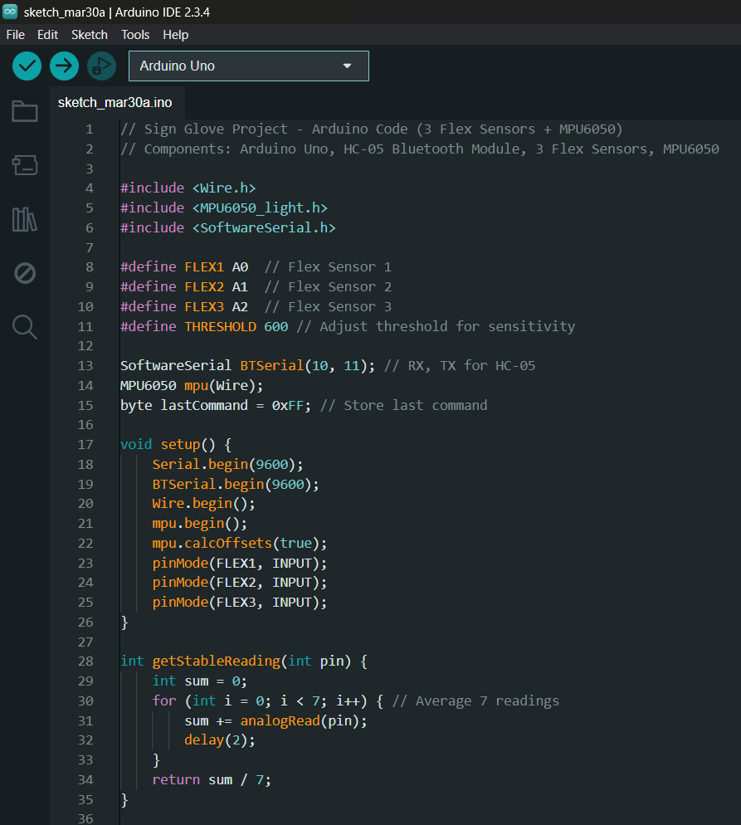
CPP CODE FOR GESTURE RECOGNITION :

Slide 13
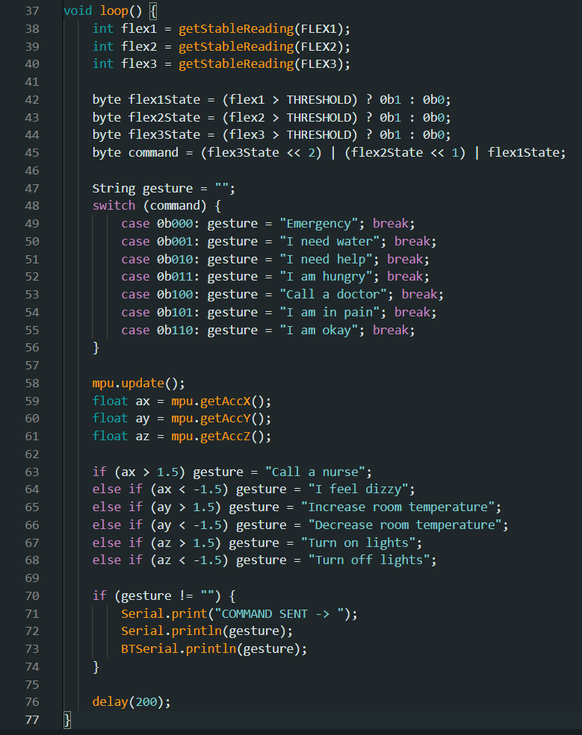

Slide 14
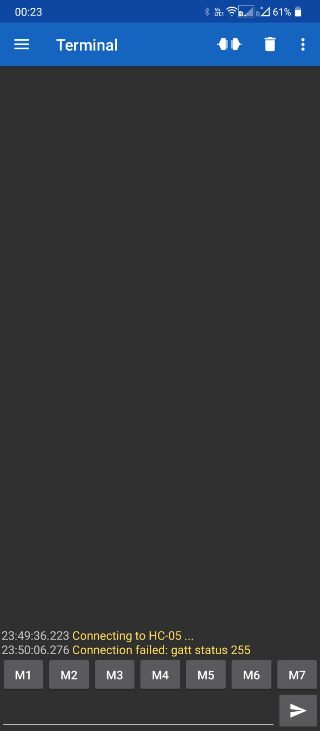
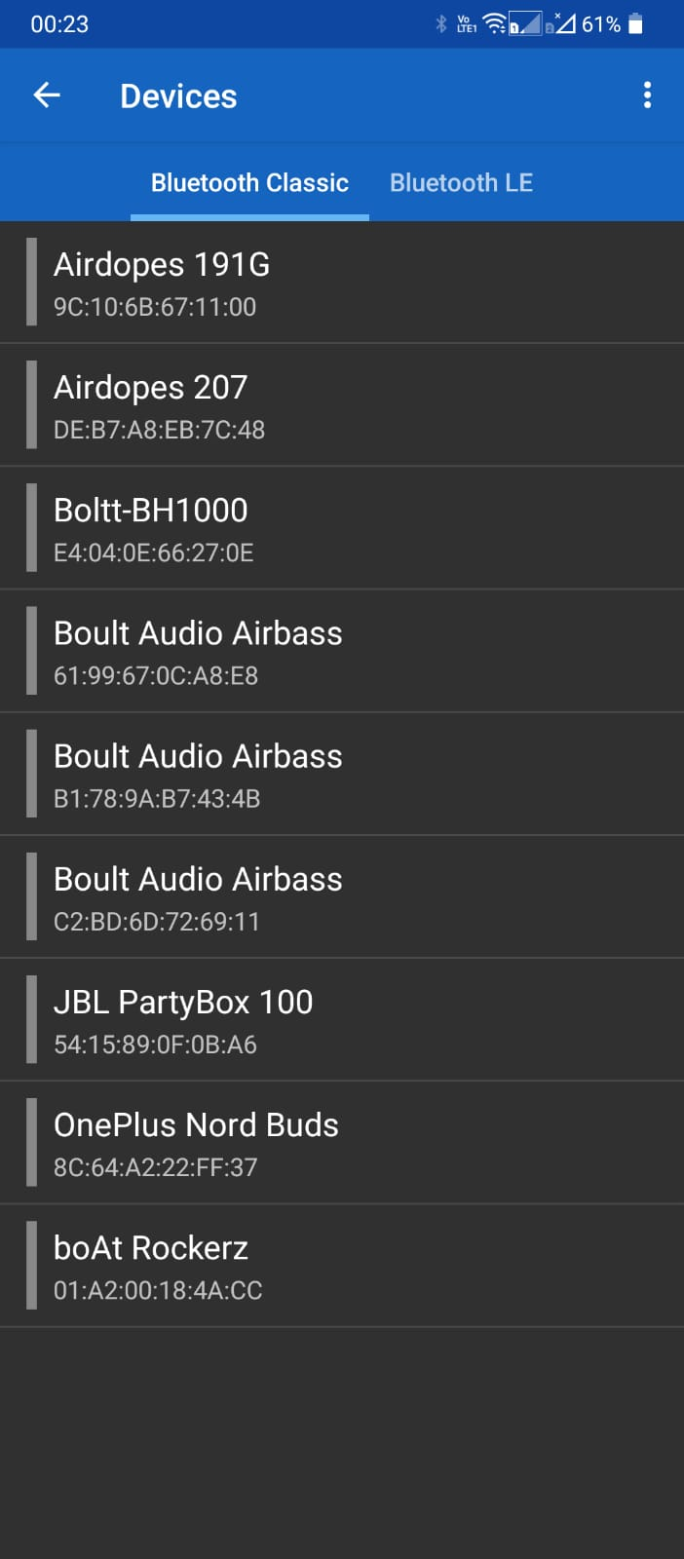
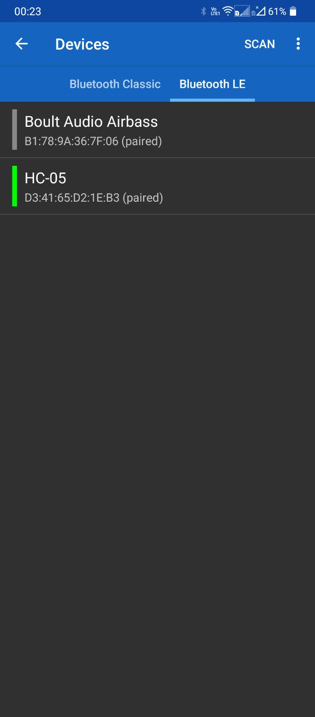
Designed Bluetooth Terminal Application :

Slide 15
Challenges Faced:
Adjusting the correct bend threshold value for the flex sensors was a little bit challenging.
Making the commands display via Bluetooth took many attempts.
We lost our flex sensor while checking for the threshold value.
Designed Bluetooth application was not the results initially and with less aesthetics.
Adjusting all components on small wearable glove was a bit hard, So we added additional space.

Slide 16
Uses of the Sign Glove for Patients 🏥🤖 :
The Sign Glove project using flex sensors + MPU6050 accelerometer provides an innovative way for patients to communicate effectively, especially for those with limited speech or mobility.
💡 Key Benefits for Patients:
1️⃣ Non-Verbal Communication
2️⃣ Quick Emergency Alerts
3️⃣ Motion-Based Assistance
4️⃣ Reduced Caregiver Workload
5️⃣ Improved Patient Comfort
6️⃣ Usable for Multiple Medical Conditions

Slide 17
🔗 How it Works for Patients :
Wear the glove (integrated with flex sensors & MPU6050).
Make a simple hand gesture → The glove detects the movement.
A command is sent via Bluetooth to a mobile device or to an android application.
Caretakers/Nurses receive the alert and take action.

Slide 18
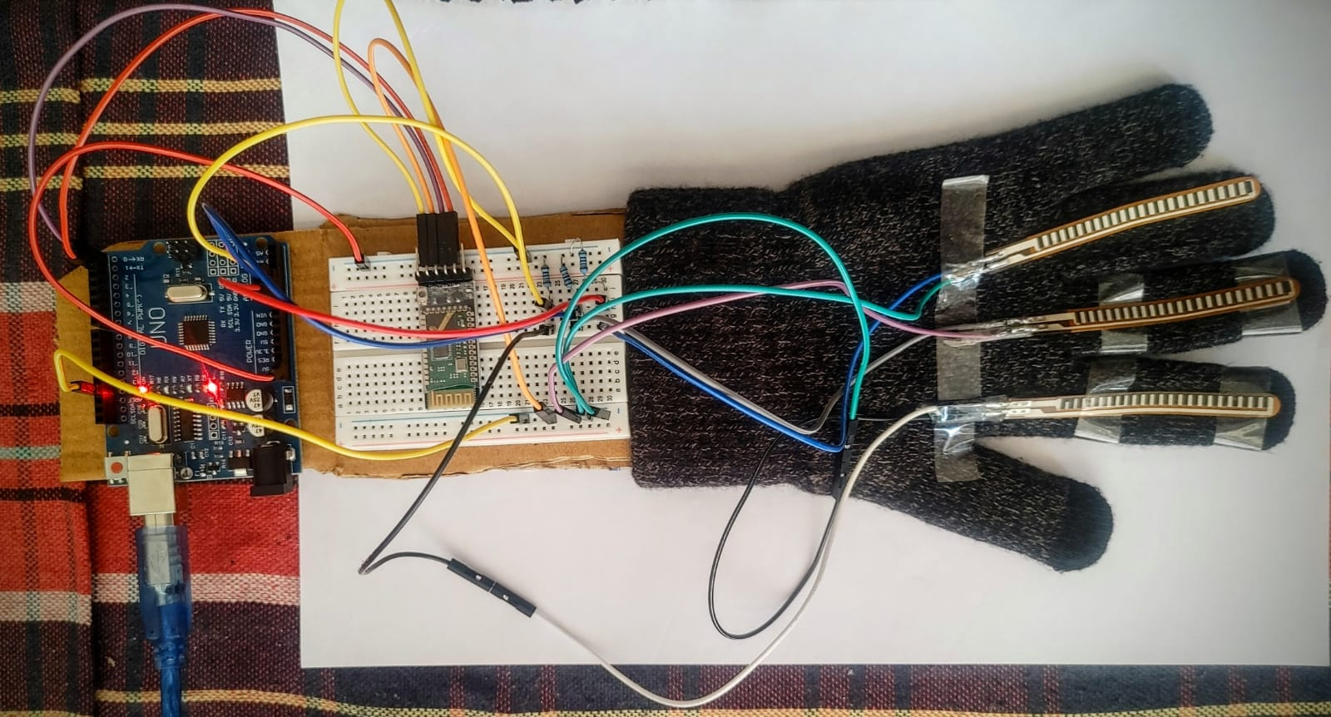
PROTOTYPE-1

Slide 19
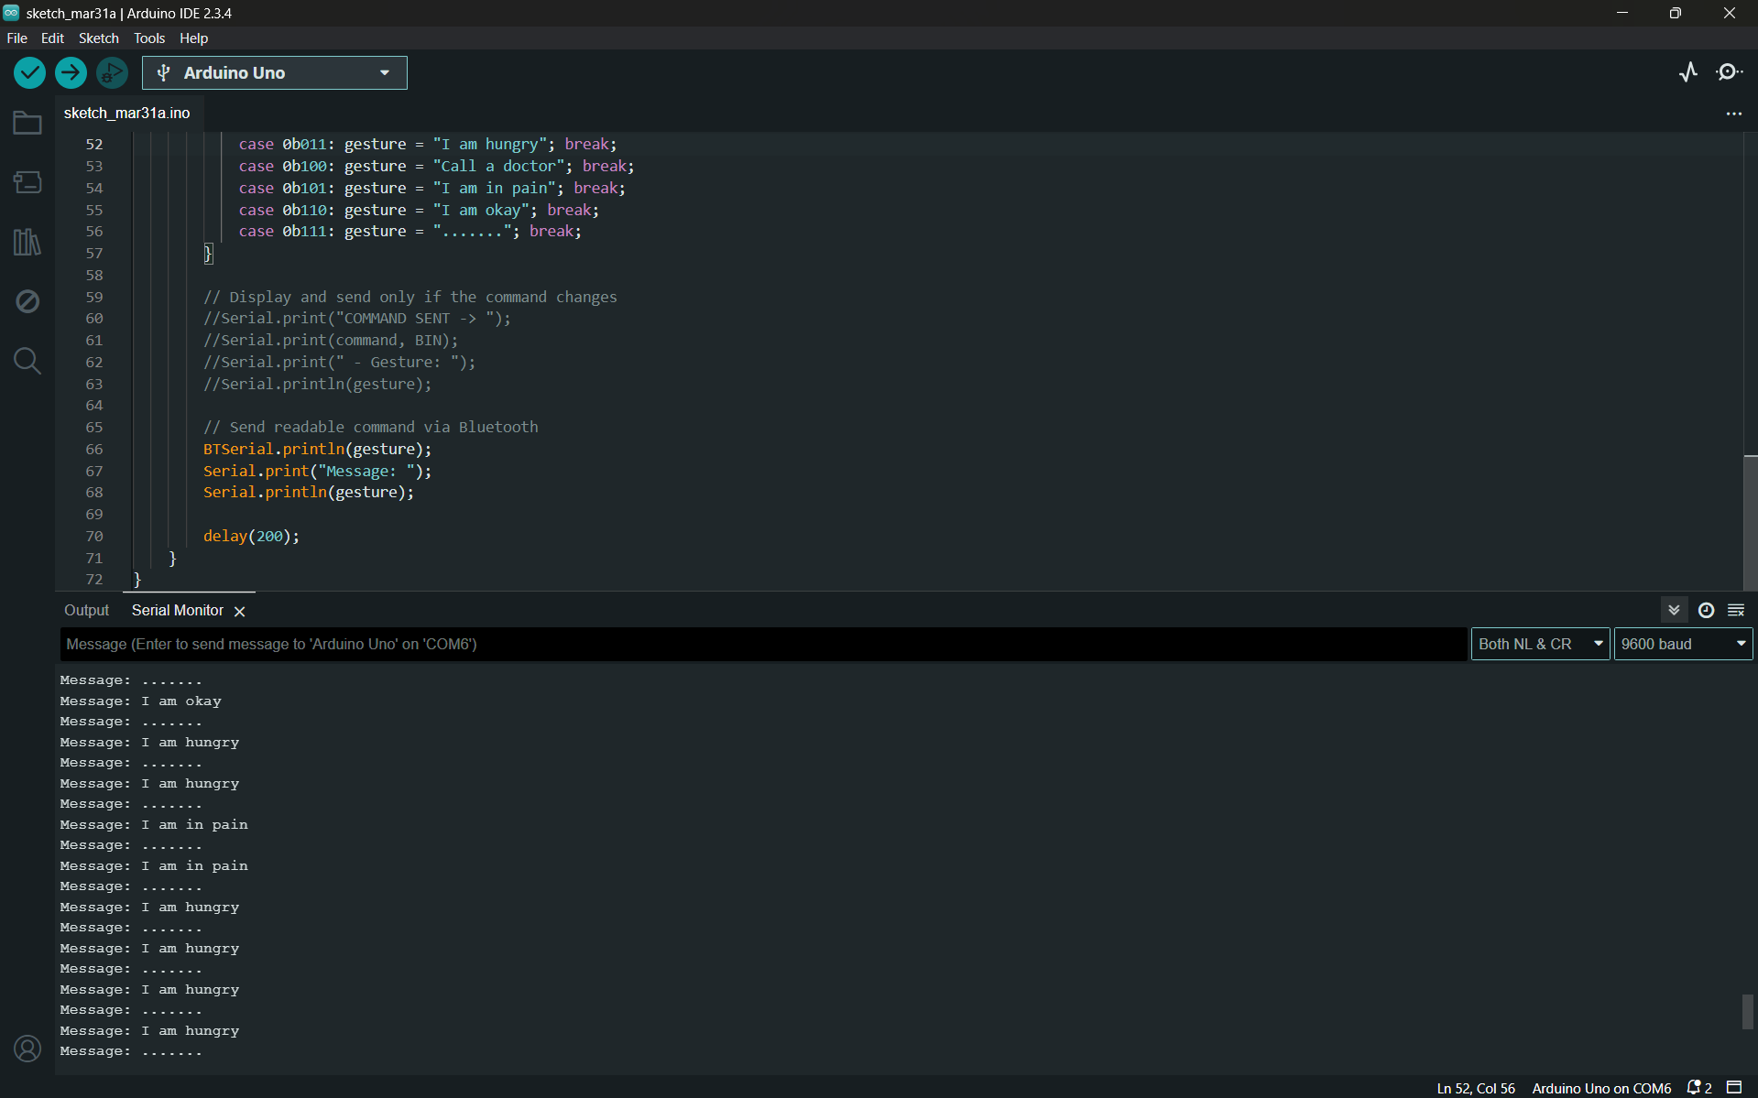

Slide 20
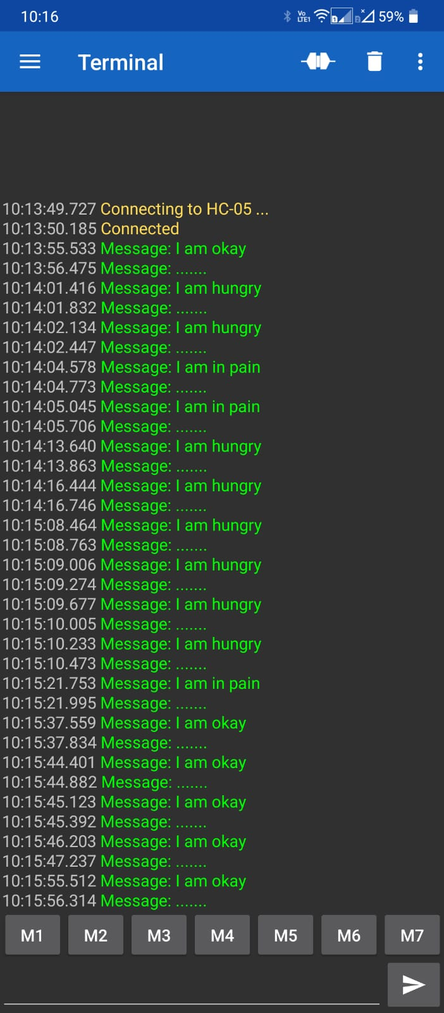
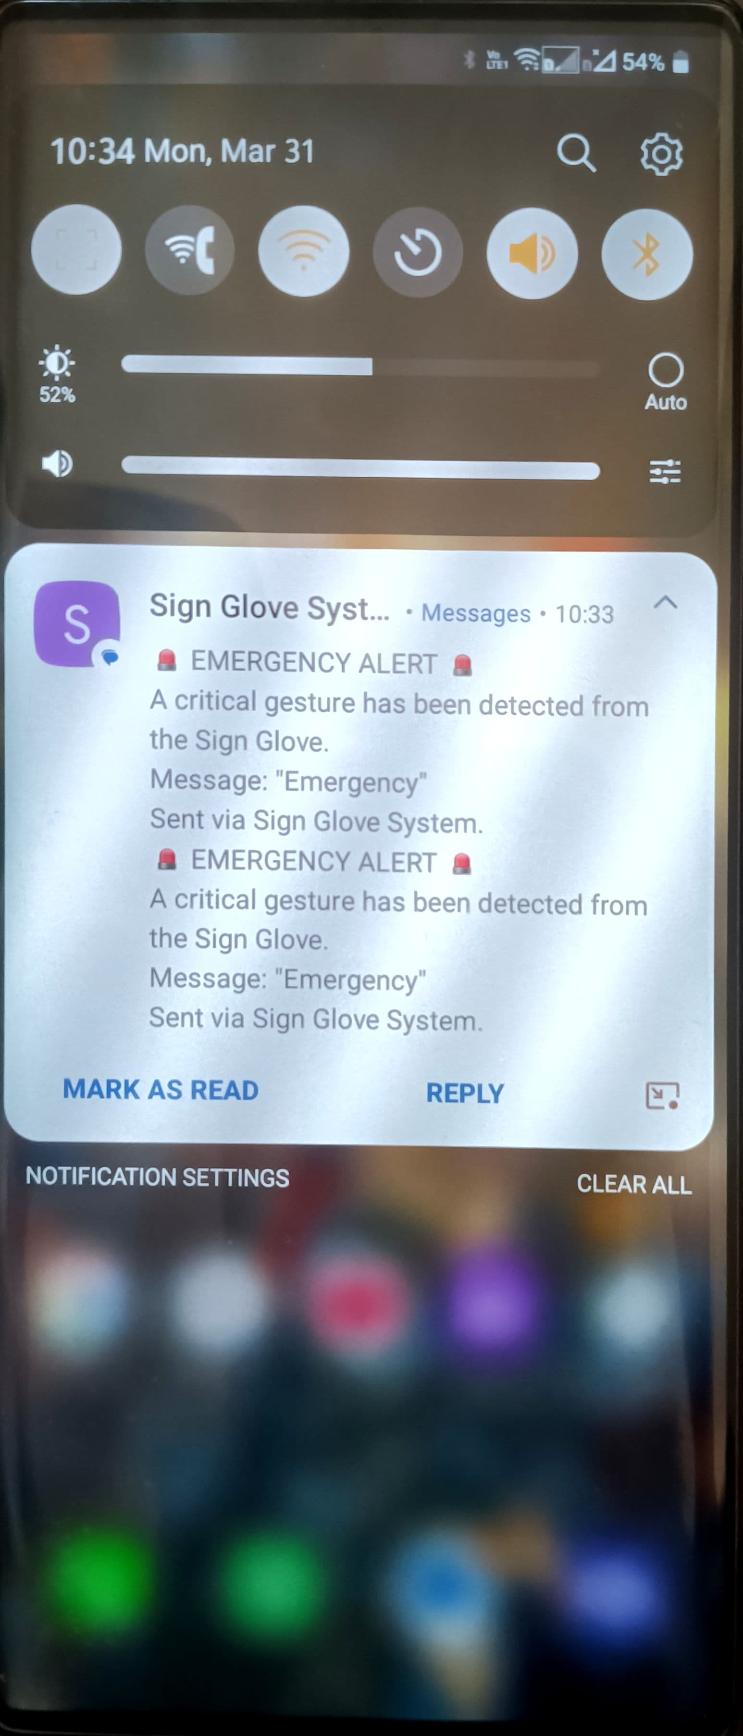
R
E
S
U
L
T
S

Slide 21
🚀 Future Enhancements:
Can add a notification system that notifies the command even when the app is not opened.
Voice feedback for real-time audio output.
AI-based prediction of patient discomfort.
Integration with hospital IoT systems for automated room adjustments.
Incorporate biometric sensors (e.g., heart rate, SpO₂, temperature) into the glove to continuously monitor patient vitals. If any abnormal readings are detected (e.g., high fever, low oxygen levels, irregular heartbeat), an automatic alert can be sent to caregivers or doctors.

Slide 22
Conclusion for the Sign Glove Project:
The Sign Glove successfully bridges the communication gap for patients with speech or mobility impairments, allowing them to convey their needs effortlessly. By integrating flex sensors and an MPU6050 accelerometer, the glove translates hand gestures into predefined commands, which are then transmitted via Bluetooth to a connected device.
This project has significant applications in healthcare, especially for bedridden patients, individuals with paralysis, and elderly patients who face difficulty in verbal communication. The system ensures quick response times from caregivers, enhancing patient care and comfort.

Slide 23

Thank you!
K Shyam prasad (122EC0006)

